Slide 1
Healthy Age Friendly Homes Programme
Marie Nolan
Regional Programme Manager,
West/ North-West Region

Slide 2
Healthy Age Friendly Homes Programme:
Context
New innovative way of working
Free support coordination service for people age 65+ years
Programme is a collaboration/ tripartite agreement between the Department of Health and Department of Housing and Age Friendly Ireland
Programme funded by Department of Health and operated by Meath County Council on behalf of local authorities
Key ethos of Age Friendly Ireland is the voice of the older person

Slide 3
Healthy Age Friendly Homes Programme:
Aims
1
3
Enable older people to continue living in their homes or in a home more suited to their needs
Be and feel part of their communities
2
4
Live with a sense of independence & autonomy
Support the avoidance of early or premature admission to long term residential care

Slide 4
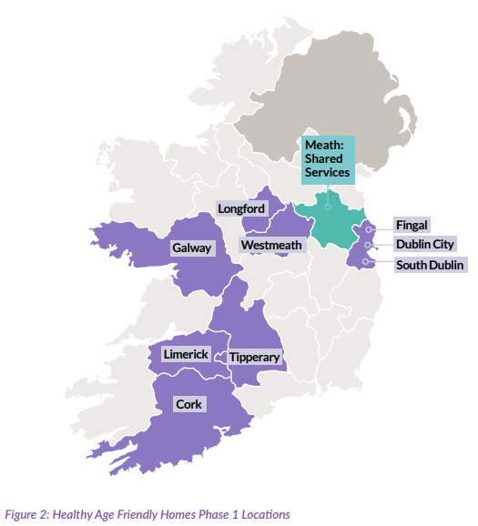
Phase 1: May 2021- 2023
Healthy Age Friendly Homes: Phase 1 Locations
Local coordinators based in 9 local authority sites
Role of 9 Coordinators:
Home Visits to people 65+years
Assessments (4 support domains)
Health, Housing, Community, Technology
Personal Plan for Support Service Access
Housing adaptation grants
Home energy improvements
Health appointments
Befriending or other community services
Technology supports
Evaluation performed by Maynooth University, the details of which are presented in the Interim Report

Slide 5
We are adopting a holistic person-centered approach
We will facilitate by:
Providing Information
Signposting to supports
Facilitative processes “handholding”
Implement Actions
Track Progress
Enable & Empower Older People

Slide 6
Referral Pathway
Self Referral
Family | Friends
Public Health Nurse
Occupational Therapist
Local Authority Staff
General Practitioners
Elected Representatives
Community Groups

Slide 7
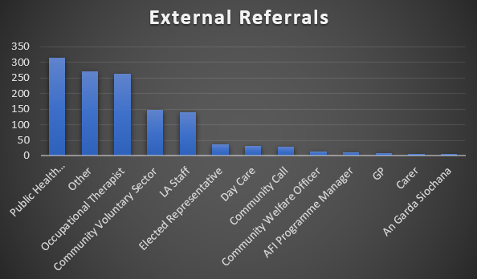
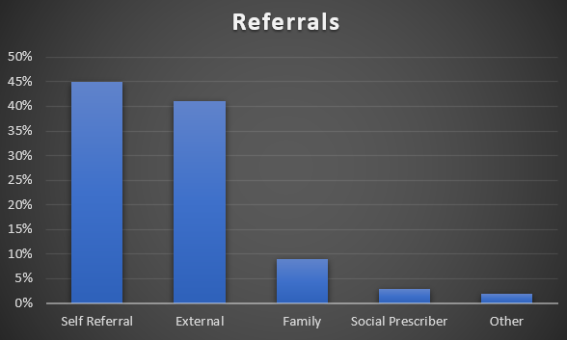
Phase 1: Referrals
Public Health Nurse/Primary Care | 328
Occupational Therapist | 263
Community Voluntary Sector | 212
LA Staff | 150
Elected Representative | 41
Day Care | 31
Community Call | 30
Community Welfare Officer | 13
AFI Programme Manager | 13
GP | 12
Carer | 7
An Garda Siochana | 6
Other | 160
Self Referral | 45%
External | 41%
Family | 9%
Social Prescriber | 3%
Other | 2%
Total | 2,868

Slide 8
Top Three Supports per Domain
Housing
Housing Adaptions
Maintenance
Rightsizing
Health
Public Health Nurse
Home Help
Meals on Wheels
Community |
Social
Befriending
Library Services
Community Group
Technology
Personal Alarm
Fall Detector
Carbon Monoxide Alarm
Finance
Fuel Allowance
Pension
Social Welfare
Energy Warmer
Home
SEAI Grants
Home Energy Assessment
Energy Information

Slide 9
Phase 1: Housing Supports | Data Breakdown
Other:
Maintenance; rightsizing,
HAP;
decluttering
Breakdown:
Grants 1,619 27%
Finance 374 6%
SEAI 927 16%
Other 782 13%
SEAI:
497 Energy Assessments;
430 Warmer Homes
& Grant Info
Total 3,702
Finance:
Fuel Allowance; Social Welfare
Notes:
So what we are looking at here is the breakdown of the Housing Supports, the percentages are based on the overall supports rather than the percentage of Housing, you will see the Grants…………..
We can see that Housing is 40% overall when you take the grants at 27% and other at 13%
I am proposing that we now move from the 4 existing Domains to six Domains Technology 15%, Community 11%, Health 12%, Housing 40%, SEAI 16% and Financial 6%. If any wants to come in here and let me know your thoughts on this move from 4 to 6. I think it is a good addition from the climate sustainability point of view and we are seeing an increase in the need for financial supports so to capture this and report to the group would be beneficial.

Slide 10
Strategic Partners
SEAI Contribution/ National Retrofitting Scheme
Mapping Tool
Evaluation- Maynooth University
Tunstall/ Technology Funding
Programme positioning

Slide 11
Strategic Partners
Up to €1.5m annual funding stream agreed.
Home Energy Assessments for Participants of HAFH
Fully inform Older Person in determining works and grants
SEAI
Tunstall Emergency Response
Procure Services to facilitate the provision of Technology Assistive Devices
Additional Sláintecare funding agreed to provide PanPan Watch and Age Friendly Tablets with 2-year monitoring, subscription and data free of charge to over 320 Participants of HAFH
Service Mapping Tool Developed
Comprehensive service map for wider scale use
Identifying services for participants
Gap analysis & Trends
Population mapping and analysis

Slide 12
Successes of HAFH Programme
Innovative support coordination service
Cross-governmental support, touches on many policy priorities
Programme provides a integrated, person-centred, holistic service
Enables older adults to ‘Age in Place’
Enables improvement of the housing stock
Increased longevity of tenancies
Enables compliance with climate commitments
Service is cost-effective and efficient
Increase in early discharge from acute hospitals

Slide 13
Phase 1
2021-2023
Phase 2
2023+
44 Local Coordinators
6 Regional Managers aligned to the new Regional Health Areas
16 Admin Support Team based in AFI Shared Service Offices Kells, County Meath
Area F – 10 Coordinators
Regional Role West/ North-West
Sligo-1
Leitrim – 1
Mayo– 2
Galway City & County – 3
Donegal– 2
Roscommon– 1

Slide 14
National Rollout: Aims
Provide older adults across Ireland with the ability to age in place or right-size to better fit their needs, through the provision of supports, housing adaptations and information, improving their quality of life.
Collaborate with other Departments and organisations across sectors to provide supports across the domains of housing, community, medical/ health and technology efficiently and effectively.
Create value for money through driving efficiency and productivity, enabling local coordinators to collaborate and learn from each other; and prevent outcomes that represent a cost to the state.

Slide 15
Phase 2: National Rollout – Expected Outcomes
Potential reach of c. 10,425 individuals annually
1 Co-ordinators allocated Roscommon County Council
Cost of potential savings €439 per participant vs. approx. €82,000 (annual cost of nursing home)
Sites | 31
Coordinators (nationally) | 44
Visits per Week (per coordinator) | 7
Total Visits per Year (44wks*) Per coordinator ** | 308
Potential Case Load – Total Visits (All Coordinators) | 13,550
Average visit per participant | 1.3
Potential Case Load – Number of People Benefitting (All Coordinators)*** | 10,425
* 52 Weeks per year adjusted to account for 30 Days AL and Bank Holidays
** Total weekly visits (7) by Co-Ordinator x 44 weeks
*** 15,400 divided by 1.3 (mean average visits)

Slide 16
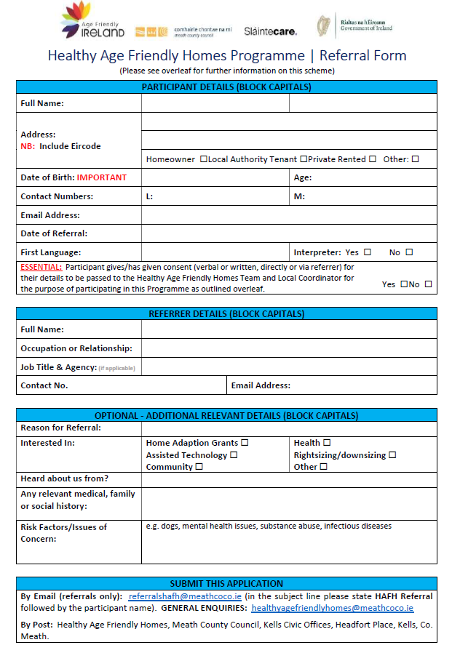
Phase 2: Referrals
Key Information
Background
Referrer Details
Participant Details
Participant Consent
Additional Information
How to Make a Referral
Complete the form
Send by email/post to Admin Team in Head Office
Once referral received and the local coordinator is in-place, we will begin scheduling home visits

Slide 17
Thank You! Marie Nolan Healthy Age Friendly Homes | Regional Programme Manager M: 085-8503869 | E: marie.nolan@meathcoco.ie

