Slide 1
Galway City Council SPC Meeting
EV Policy
22nd February 2023

Slide 2
Contents
Summary of the Presentation
Section
Setting the Scene
Reflecting on Galway’s Perspective
Focus area for Policy Development
Methodology
Challenges/Considerations

Slide 3
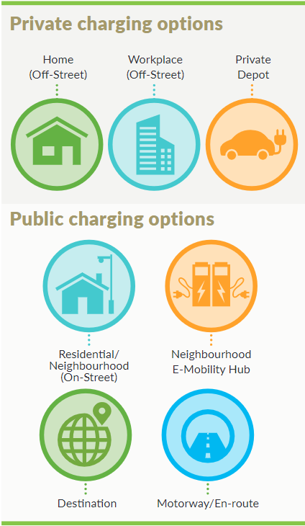
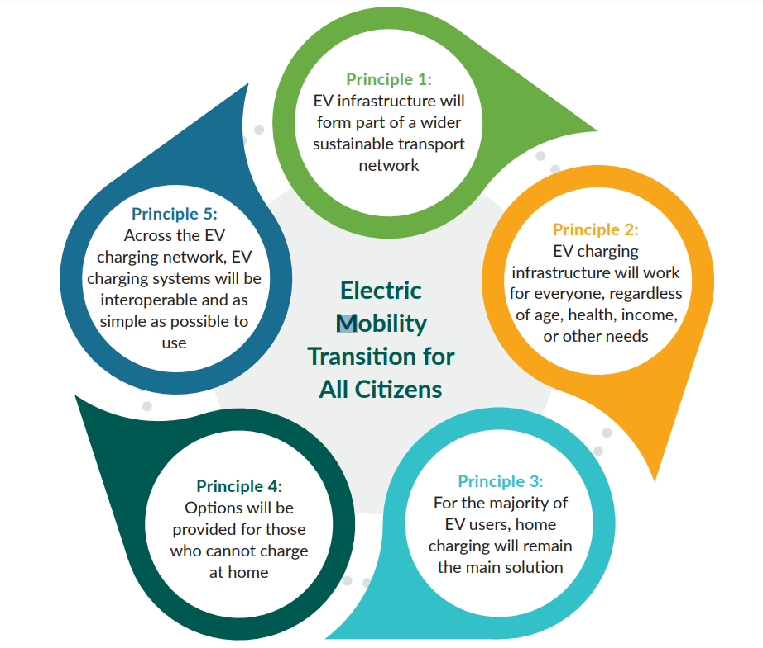
EV Charging Infrastructure 2022-2025
National Context

Slide 4
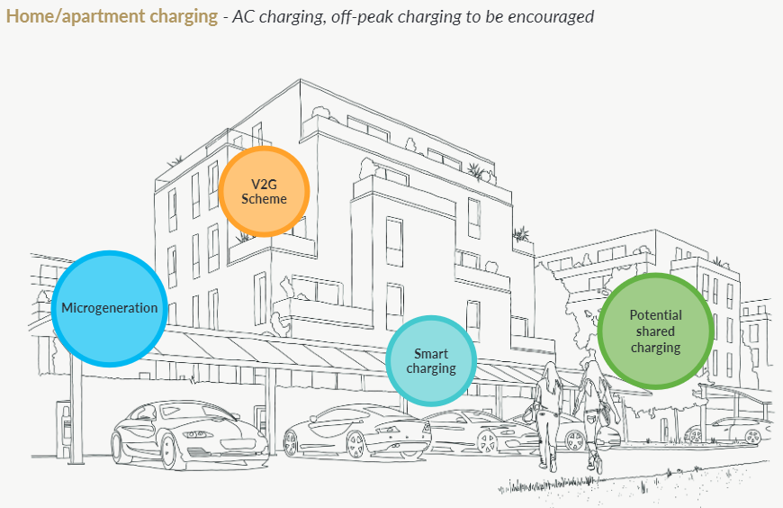
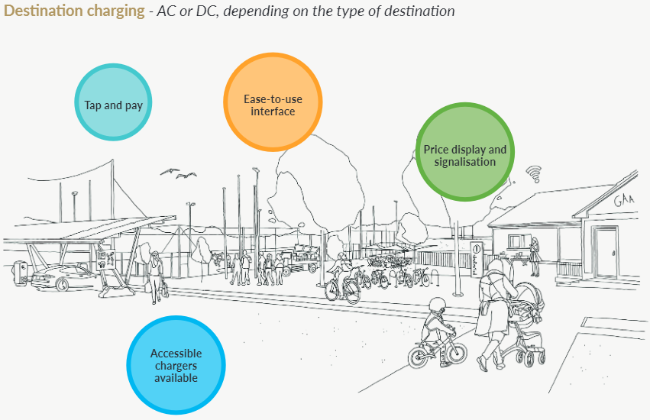
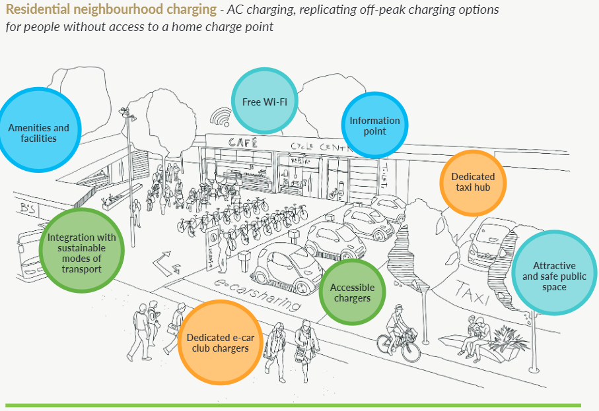
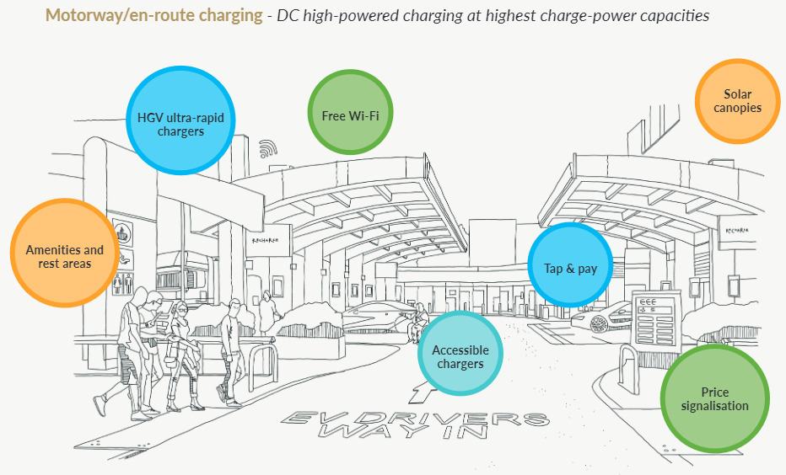

Slide 5
EV as part of a City Development Plan
EV Context
EV recharging infrastructure shall meet the requirements of Statutory Instrument No. 393/2021 - European Union (Energy Performance of Buildings) Regulations 2021. These are the minimum standards for EV charging points and infrastructure:
New buildings or buildings undergoing major renovations (other than a dwelling) shall install at least one recharging point and ducting infrastructure for at least one in every 5 car parking spaces to enable the subsequent installation of recharging points for electric vehicles.
New buildings or buildings undergoing major renovations (containing one or more than one dwelling), which has more than 10 car parking spaces, shall install ducting infrastructure for each car parking space to enable the subsequent installation of recharging points for electric vehicles.
For an existing building (other than a dwelling) with more than 20 car parking spaces, one, or more, recharging points will be required to be installed, before 1 January 2025.
New dwellings with on-site car parking should be developed with appropriate infrastructure (ducting) that enables future installation of a charging point for EVs.
Publicly accessible EV parking spaces should be clearly marked and be capable of communicating usage data with the National Charge Point Management System. EV parking spaces for disabled spaces should also be included developments.
Electric car charging points – 10% of communal and private spaces shall be adapted and suitable for Electric car (EV) chargers. The Council will also endeavour to install additional EV charging points for public spaces throughout the city having regard to the sensitivity of the locations.
The Council are committed to work in conjunction with ESB networks and other service providers in the provision of charging points in public areas in the city, to ensure there are appropriate levels of electric charging infrastructure in place, including at public transport interchanges
https://www.galwaycity.ie/gccfiles/?r=/download&path=L0RlcGFydG1lbnRzL1BsYW5uaW5nL0RldmVsb3BtZW50IFBsYW4vMjAyMy0yMDI5L1N1cHBvcnRpbmcgRG9jdW1lbnRhdGlvbi9JbnRlcmltIEdhbHdheSBDaXR5IERldmVsb3BtZW50IFBsYW4gMjAyMy0yMDI5X0ZJTkFMLnBkZg%3D%3D

Slide 6
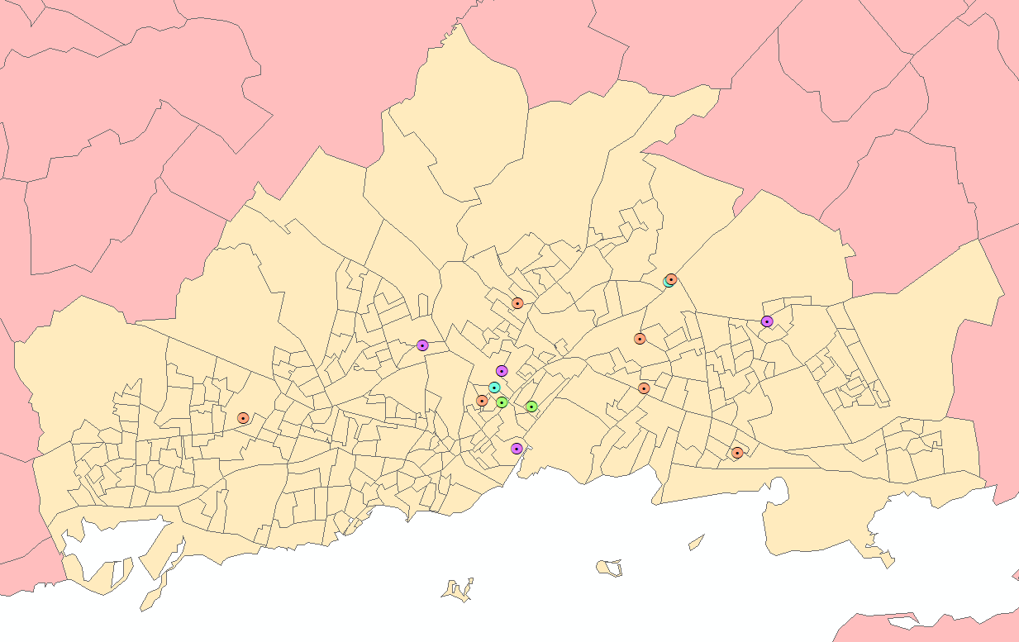
EV Charge Points in Galway
EV Charge Locations
The below shows Galway City in Yellow with the different
charge points spread across the city.
It is based on available data.
3kW 4 (Green)
7kW 4 (Blue)
11kW 0
22kW 21 (Orange)
50kW 8 (Purple)
100kW 0
150kW 0
Total 37

Slide 7
Focus Areas
Sustainable and Fair
Create a Policy that:
Task A: Facilitates the uptake of Electric Vehicles by people that do not have off-road charging:
Task B: Promotes a sustainable and equitable approach to EV charging
Task C: Supports the Local and National ambitions for EV and Mobility .
Task D: Considers the implications in terms of engagement with the market

Slide 8
Methodology
Activities
Situation ReCap
80% of all charging will be done by Home charging via houses with their own charge points. This focus here is to support all those residents that do not have this facility available to them.
Evolving EU and National Strategies Policy linked to Galway’s activities and plans
Review of Policy context in 3 other Cities to inform the work.
Considerations
Installation a Charge Point on a parking bay (for Terraced Housing) has an implication on the utilisation of parking space
Communal charge points and availability and impact on users in the short/medium term .
Utilisation of Street Lights requires Public lighting cabling to be suitable, clarity on provision of power to a 3rd party and location of light in relation to the kerbside.
Charging via cabling from houses across the footpath under a safety map has a safety impact, both in terms of cables on a footpath/ Standards going from Public to Private
Apartment buildings look to follow the EU directive in terms of 10% minimum availability
Approach
Policy
Considerations for Next Steps
Establish the Policy foundation based on EU/National activities
Understand the challenges to support the 20% in a sustainable and fair approach
Develop the Policy and Next Steps

Slide 9
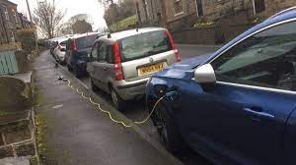
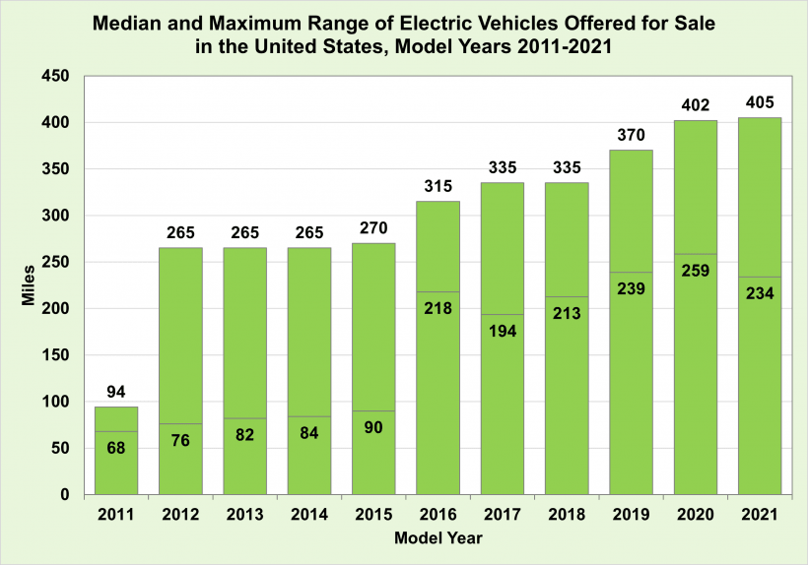
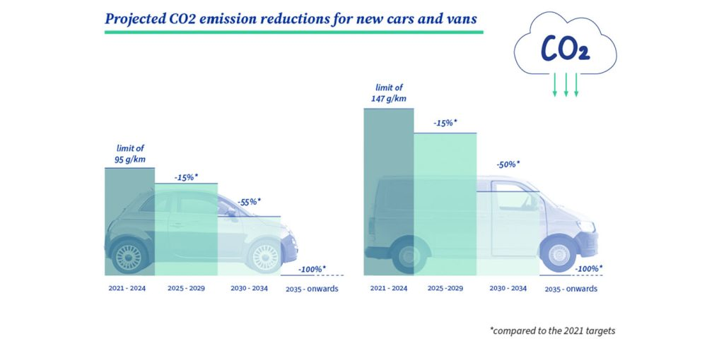
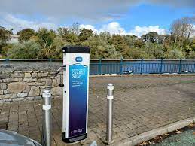
Challenges/Considerations
Practical Challenges
Cabling Challenges
Range Anxiety Reality Check
2035 Ban on New ICE
Parking Bay Use
Equitable Pricing
Energy Availability

Slide 10
AOB

