Slide 1
Galway City Vacant Site Register
Planning Strategic Policy Committee Meeting
1st September 2020
Kate Moloney, Assistant Planner

Slide 2
Overview
Origins + purpose of the Vacant Site Levy
Procedure for entry on register
Galway City Vacant Site Register
Next steps
Questions ?

Slide 3
Origins + purpose of the Vacant Site Levy
Introduced by the Urban Regeneration & Housing Act 2015. The Planning and Development (Amendment) Act 2018 increased the VSL rate, from 3% of the market value of a vacant site for 2018, to 7% for 2019.
Purpose - site activation and incentivisation measure to ensure that vacant or underutilised land in urban areas is brought into beneficial use.
Vacant site
“site” means any area of land exceeding 0.05 hectares identified by a planning authority in its functional area but does not include any structure that is a person’s home.
Residential land - the site must be situated in an area in which there is a need for housing and a suitability for the provision of housing, and the majority of the site must be vacant;
Regeneration land - the vacant site must exhibit an adverse effect(s) on existing amenities, or reduce the amenity provided by existing public infrastructure and facilities.

Slide 4
Procedure for entry of sites onto the Vacant Site Register
1
Preliminary Assesment
2
Identification of potential vacant sites
Identification of individual sites
3
Deemed to be Vacant for the preceding 12 months
4
Notification of landowners
Written notice setting out reasons for the proposed entry
- 28 days to respond
Entry onto the register
Written notice of entry to the register
- 28 days to appeal to ABP

Slide 5
Procedure for entry of sites onto the Vacant Site Register
8
Collect VSL
Must be paid within 2 months of issue of demand
7
6
Demand for payment
Notification of Market Value
Issued from 1 Jan for preceding year. Opportunity to appeal within 28 days to An Bord Pleanala
Written notification issued to the site owner of market valuation
- Appeal within 28 days to Valuation Tribunal
5
Market Value
Planning Authority to establish market value

Slide 6
What has been the process to date?
Preliminary assessment – commenced late 2016
Identified 86 sites
Assessed and prioritised against 5 criteria
Vacant Site Register established in 2019
Appeals - 1 appeal to ABP April 2019 – determined July 2020
Death / Change of Ownership – VSL reduced to zero for that year and preceding year (except where the change of ownership is to a connected person)

Slide 7
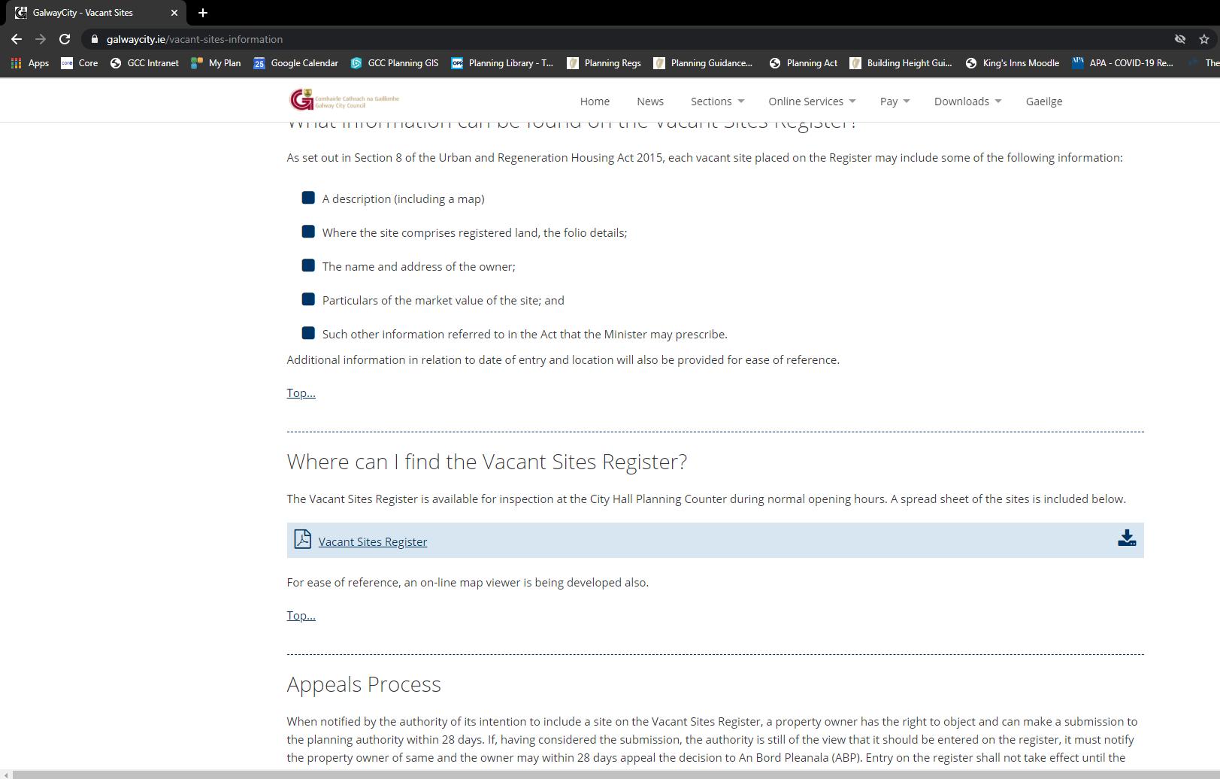
Galway City Vacant Site Register
Available here:
https://www.galwaycity.ie/vacant-sites-information
Galway City Vacant Site Register Summary [August 2020]
No. of sites | 6
Total Area (ha) | 5.14
Total value | €4,600,000
Total VS Levy liability [@7%] | €322,000
Estimated no. of housing units (35-50 uph) | 180 – 257 units

Slide 8
Next steps
Currently reviewing next tranche of sites
Collect vacant site levy – January 2021
Proceeds of vacant site levy - retained by Local Authority
- 10% may used for collection and administrative costs
- Remainder of proceeds to be used by Local Authorities for the provision of housing and regeneration development in the local areas in which the vacant sites are located.
Parliamentary Budget Office – Analysis of VSL
Challenges in implementing and administering the Vacant Site Levy (May 2020)
The Vacant Site Levy (and broader market context) (July 2020)

Slide 9
Questions?
Thank you ☺
kate.moloney@galwaycity.ie

