Slide 1
Galway City Community Network The Public Participation Network in Galway City Plenary Meeting December 5th 2018
Fáilte/Welcome

Slide 2
Agenda
GCCN
Minutes and Matters Arising
GCCN Representatives Input
AOB
Presentations
Brief update on GCCN activities
Galway2020
Galway City Council
Notes:
Matters Arising?
Ratification of decisions from March Plenary
Elections:
Secretariat – Joan Kavanagh
JPC – John Cleary
Childcare Committee – Marian Moloney
Associate membership

Slide 3
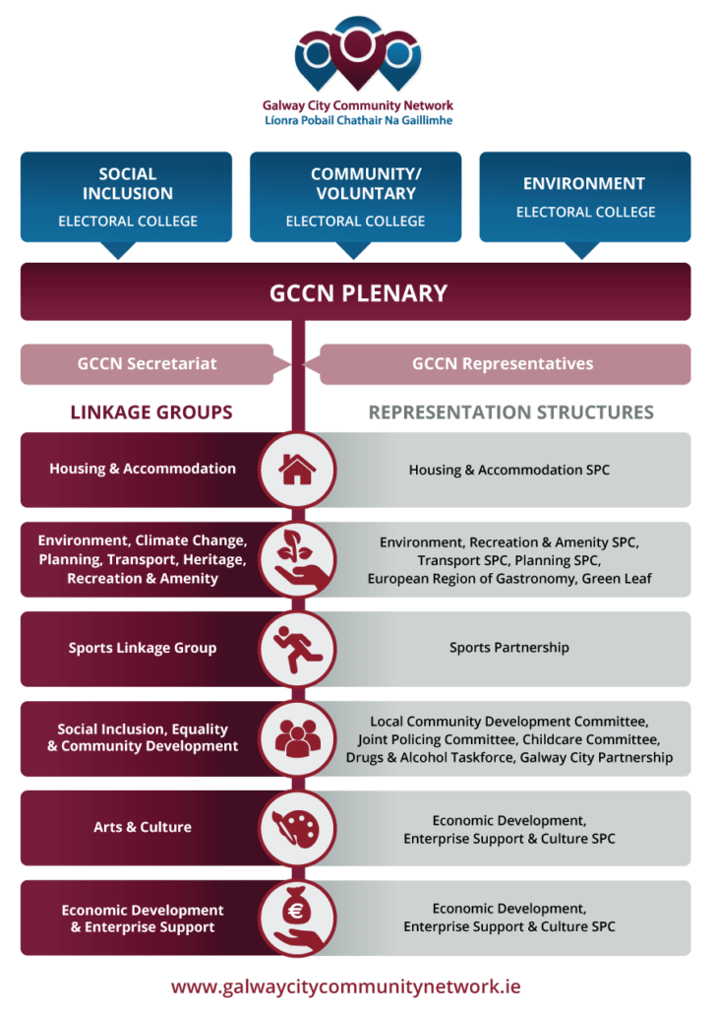
2018 Roundup
Approach
Colloboration
co-ordination
Added-value

Slide 4
Representation
Local Community Development Committee (LCDC)
Strategic Policy Committees
Housing and Accommodation
Environment
Planning
Transport
Economic Dev, Ent Support & Culture
Joint Policing Committee
Childcare Committee
Galway Sports Partnership
Galway City Partnership Board
Comhairle na nÓg
Linkage Group Meetings and Pre Meetings with Reps

Slide 5
GCCN Representatives
LCDC – Terry Mc Donough/Marian Maloney/Margaret Ó Riáda/James Coyne/Tommy Flaherty
Planning – Shane Foran/Derrick Hambleton
Transport SPC – Niall Ó Brolocháin /Derrick Hambleton
Environment, Recreation and Amenity SPC – Caroline Stanley/Brendan Smith/Eleanor Hough
Economic Development, Enterprise Support & Culture SPC - Garry Lohan/Maeve Mulrennan
Housing & Accommodation SPC – Karina Timothy/Karen Golden
Galway City Partnership – Martin O'Connor/Kathy Higgins/Tommy Flaherty/Maria Molloy
Joint Policing Committee – Nicola Tierney/Tommy Flaherty/John Rabbitte/John Cleary/Joe Loughnane
Child Care Committee – Marian Moloney
Comhlaire na nÓg - Fiona Jennings
Sports Partnership – Kerrieann Faherty/Chris Hickey/Aidan Reade
Alcohol Forum – Tommy Faherty
European Region of Gastronomy – Martina Finn

Slide 6
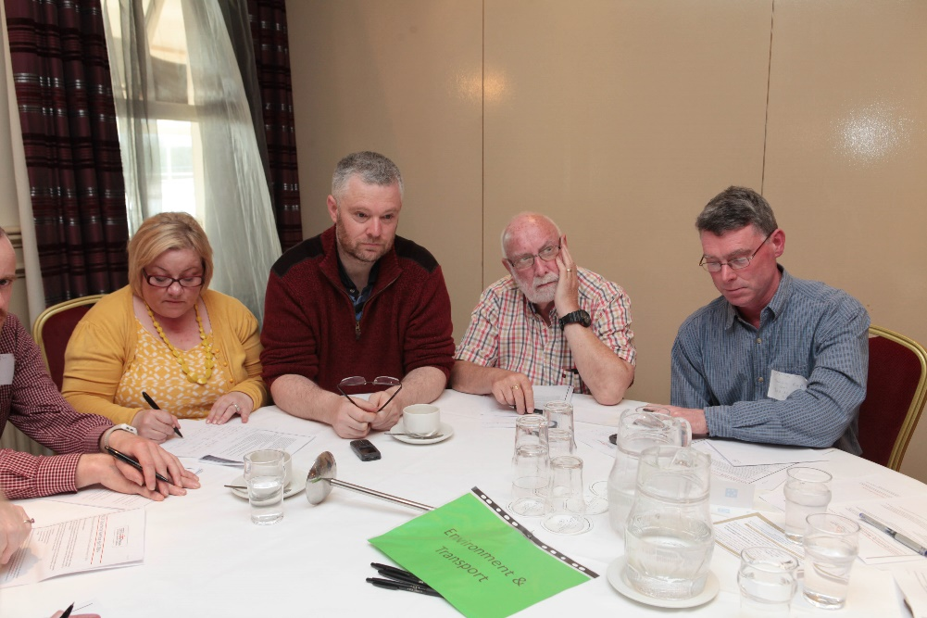
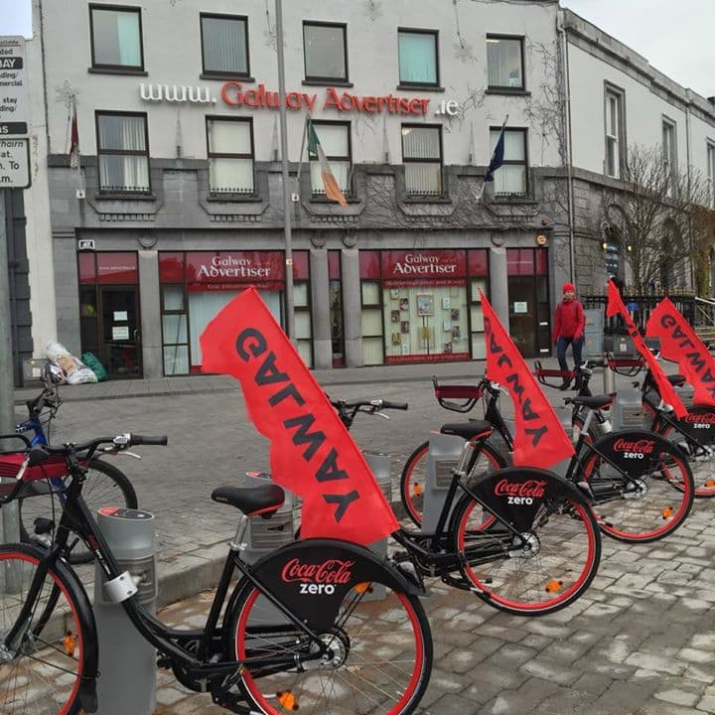
GCCN Members’ meetings
Grouping | Meetings 2018
Plenary | 4
Secretariat | 10
Environment LG | 4
Social Inclusion & Community Development LG | 3
Housing & Accommodation LG | 4
Sports Reps Meeting/Galway Sports Partnership/Public mtg | 4 3
Economic Development, Enterprise Support & Culture LG/Reps
LCDC reps | 2
JPC reps pre-meeting/public meeting | 3
Child Care Committee | 2
Comhairle na nÓg | 2
Alcohol Forum | 2

Slide 7
Purpose of Representatives Reports

Slide 8
2018 GCCN Membership & Re-registration
Members | December 2018 | Re-registration
Registered | 131 | 63
Social Inclusion Pillar | 63 | 27
Environment Pillar | 15 | 5
Community Pillar | 72 | 30
Membership -re-registration through direct contact, e-mails, meetings, social media, (Facebook, website, newsletter etc.)
Induction meetings – general and targeted (deferred to 2019)

Slide 9
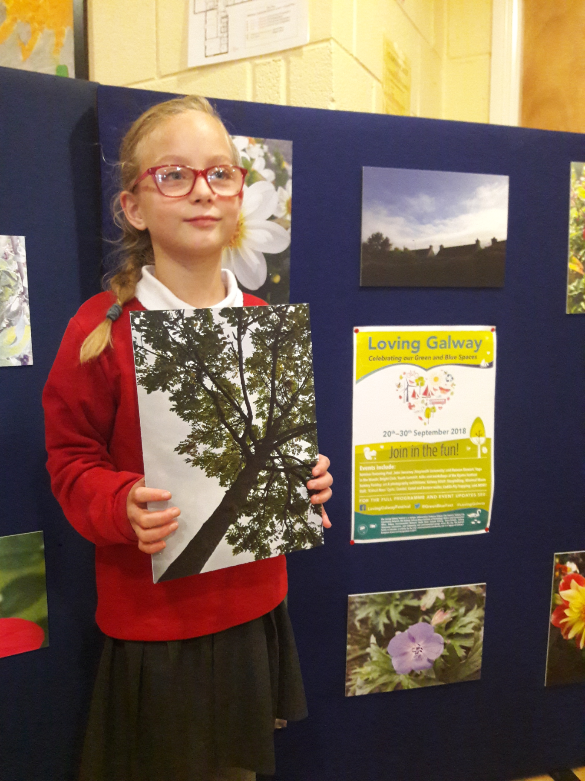
2018 Highlights
Events
Participation
Submissions

Slide 10
Events
Loving Galway
Ideas for a Beautiful Planet - Conference in NUIG – 23rd Sept
Make Way Day Campaign (26th Sept)
Communities –The Bridge Project, Beautiful Ballybane, Recycling Workshops, Yoga in the Woods
Family Day in association with the Oyster Festival – Sunday September 30th
Your City Your Say – Saturday 29th Sept
Homelessness event
Collaboration with GCCN members
Flowers for Magdalenes

Slide 11
Participation
Insight
G2020
Healthy Galway
GEN
Legacy Event
The development of the Healthy Galway Strategy
The support for the emerging Healthy Galway Forum
The successful application to Healthy Ireland Round 2:
Flagship programme
Nutrition
LBGTI Health Resource Worker
Establishment
Presentation

Slide 12
Participation
Equality & Human Rights
Disability Thematic Group
National Level
PPN Conference (11th/12th Oct)
Resource Workers’ Meetings (4 times per year)
GCCN – member of the LCDC Social Inclusion Subgroup
Developed an Equality and Human Rights Statement
Successful application to fund work to develop the statement and promote the Public Sector Duty amongst statutory members of the Local Community Development Committee
Make Way Day (26th Sept)
UNCRPD Workshop (19th Oct)
Celebration of International Day for People with Disabilities (3rd Dec)

Slide 13
LECP Implementation Plan
Proposal submitted to Galway City Council
Development of a new implementation plan
Based on robust consultation and needs analysis

Slide 14
Submissions
New National Action Plan for Social Inclusion
Regional Spatial & Economic Strategy – issues paper
Currently working on:
The Ring Road project
Regional Spatial & Economic Strategy – draft

Slide 15
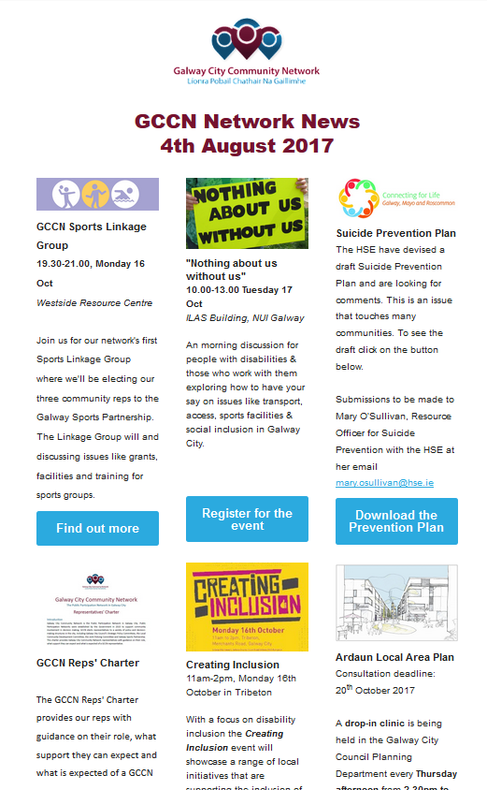
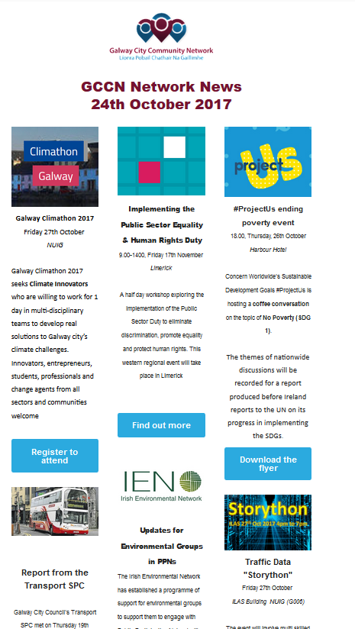
GCCN Network News

Slide 16
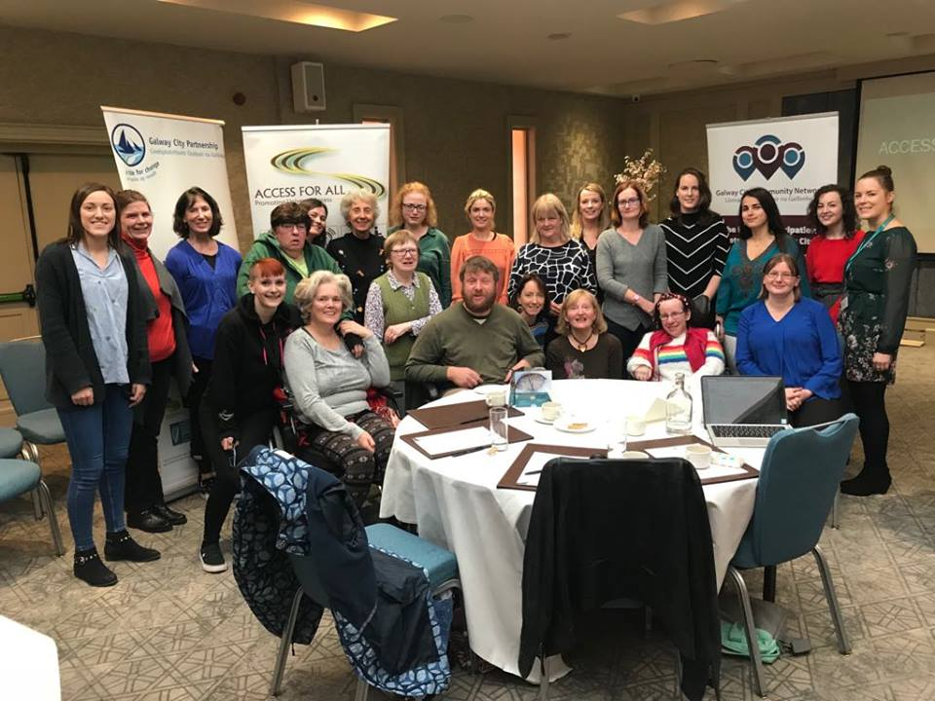
Training
Data Protection – 2 training sessions - 19th April
Public Sector Duty – GCCN, LCDC and GCP hosted a workshop delivered by Equality Rights Alliance
GCCN and GCP facilitated the delivery of UNCRPD workshop by Disability Federation of Ireland

Slide 17
Presentations to Plenary Presentations to GCCN Plenary Galway City Council – Tom Connell Galway 2020 – Nollaig Mc Guinness

