Slide 1
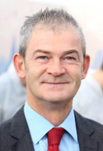
Galway City Community Network – Housing Workshop
Family Hub Initiative
Ned Brennan Chief Operations Officer
26th February 2018
www.respond.ie

Slide 2
The role of the Housing Association:
helping to meet the housing challenge
ensuring quality housing provision
View of the Houses
www.respond.ie

Slide 3
Background
Low output of social housing for previous decade.
Scarcity of social housing.
Lack of construction of new dwellings.
Over reliance on the private rented sector.
Shortage of private rented accommodation.
High rents.
Low income families squeezed out of rental market.
Growth in family homelessness
Reliance on hotels and B&B’s
View of the Houses
www.respond.ie

Slide 4
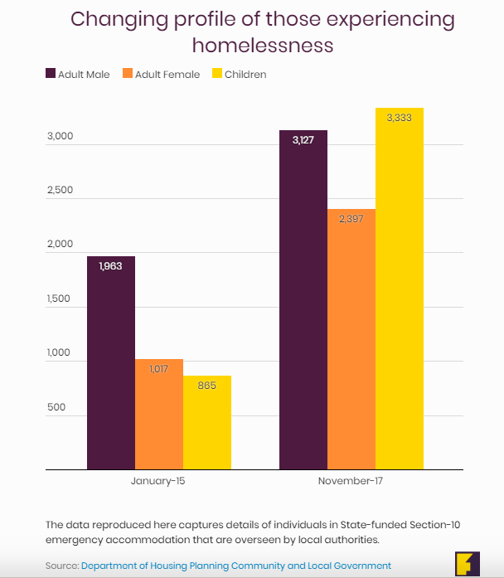
View of the Houses
www.respond.ie

Slide 5
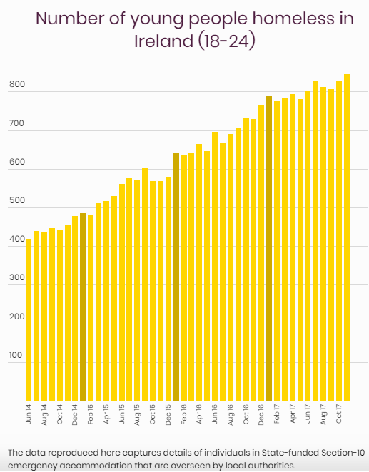
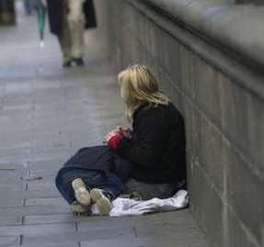
View of the Houses
www.respond.ie

Slide 6
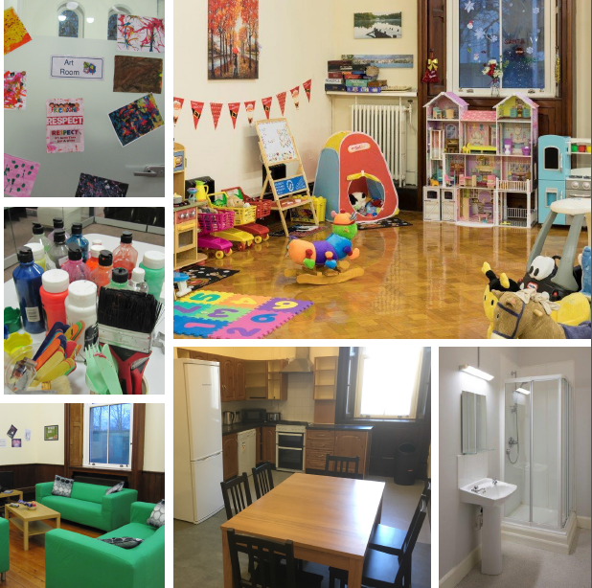
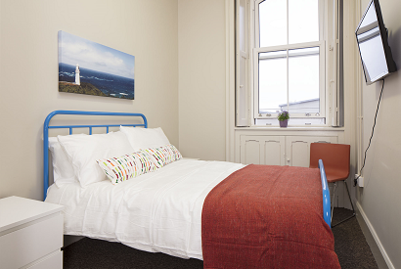
Respond! Family Hub Initiatives
Respond! Family Hub - Clontarf
Our newest Family Hub opened as a homeless service in last December
Respond! Family Hub - Drumcondra
Family Hub opened as a homeless service December 2016. Launched by Minister Coveney in March 2017
Respond! Family Hub - Tallaght
Respond! re-opened Cuan Álainn Family Hub as a homeless service for women & children Nov. 2016
Video : https://youtu.be/RfzwptYLAMo
Respond! Suaimhneas, Limerick
This centre opened in November 2002 to provide emergency accommodation for homeless women and their children
View of the Houses
www.respond.ie

Slide 7
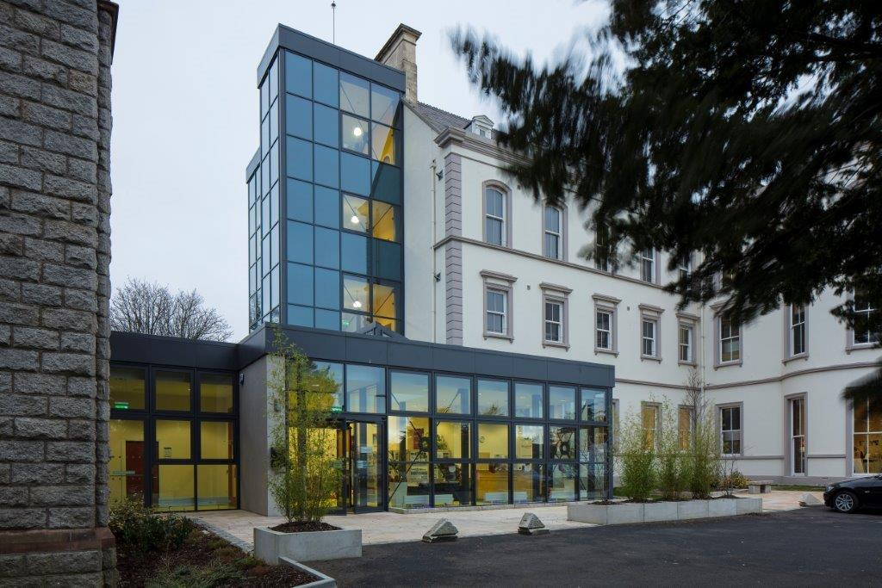
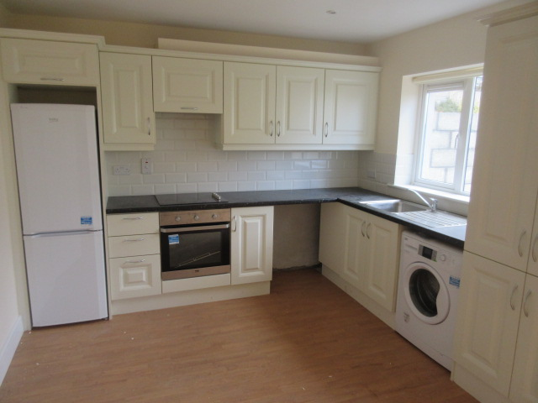
Accommodation
View of the Houses
www.respond.ie

Slide 8
Accommodation
En-suite rooms or apartments.
Containing fridge, microwave, kettle and television.
Communal kitchen area per 4 rooms.
Communal sitting room.
Laundry facilities.
Children's Playroom.
Art room.
Restaurant.
View of the Houses
www.respond.ie

Slide 9
Family Hub - Drumcondra
Details | No.
Number of Units | 35
Number of Families | 29
Number of Occupants | 64
Number of Adults | 31
Number of Children | 33
Number of Children Aged 0-5 | 26
Number of Children Aged 6-10 | 3
Number of Children Aged 11-15 | 4
1 Adult + 1 Child | 25
1 Adult + 2 Children | 2
2 Adults + 1 Child | 1
2 Adults + 3 Children | 1
View of the Houses
www.respond.ie

Slide 10
Family Hub – Tallaght
- 9 families (9 adults and 24 children) have been placed in Private Rented accommodation and local authority housing the last year.
View of the Houses
www.respond.ie

Slide 11
Caring new model of accommodation which
includes a range of wrap-around services to
help homeless families be in a better position to move to secure housing in the short term.
Services are tailored to needs of individual parents and children. Every family will have a keyworker and a support plan will be developed with every resident based on need.
This is transitional accommodation designed to be as close to a home as possible and to ensure that every person and child leaves the facility in a better position than when they arrived.
View of the Houses
www.respond.ie

Slide 12
Family Hub Supports and Services
- Case Management and Key-working
- Access to Entitlements (Medical Card, Social Welfare, etc.) and Mainstream Services (Healthcare, Welfare, Education)
- Information/accommodation research facility.
- A hot nutritious meal every day.
- Internal and external play areas.
- Independent Living Skills, i.e. budgeting, cookery and personal and life skills
- Access to Public Health Nurse.
- MABS Support
- The High Park Family Hub will also run a Breakfast Club and an After School Club
- A teenager hub/chill out room.
- Art room.
- Laundry Facilities
View of the Houses
www.respond.ie

Slide 13
Family Hub Staffing
Service Manager
Full-time Project Worker x 8
Part-time Project Worker x 2
Relief Project Worker
Concierge 24/7
Chef Manager
Kitchen Assistant
Weekend Kitchen Assistant
Breakfast Club / After School Club Staff
Cleaner
View of the Houses
www.respond.ie

Slide 14
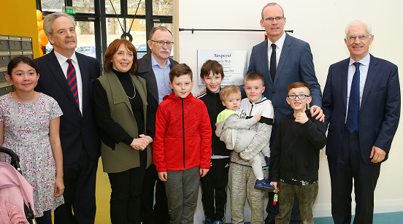
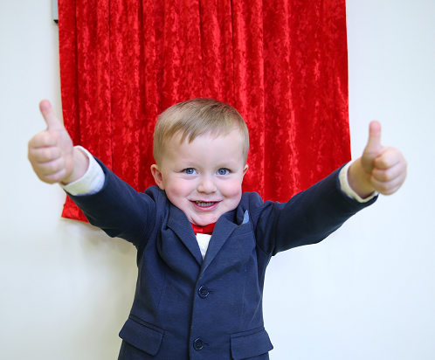
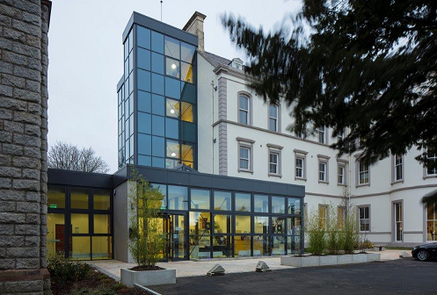
Minister Coveney launched the new Family Hub model of accommodation in Drumcondra in March 2017
Carter Kennedy aged 3 pictured at the Launch of a Respond Family Hub.
www.respond.ie

Slide 15
Future Plans for Family Hubs
Galway
Limerick
Waterford
Wexford
Carlow
View of the Houses
www.respond.ie

Slide 16
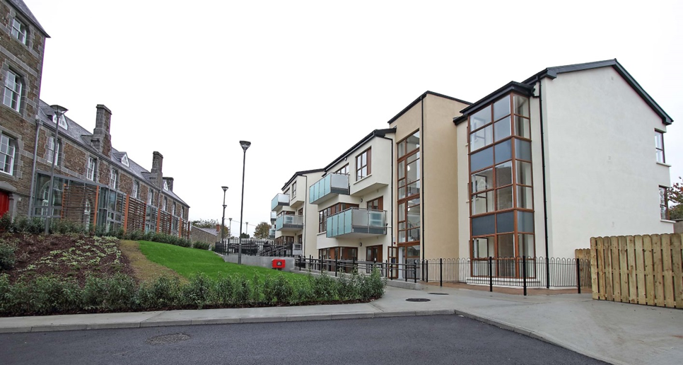
Thank you. I am happy to take any questions
www.respond.ie

