Slide 1


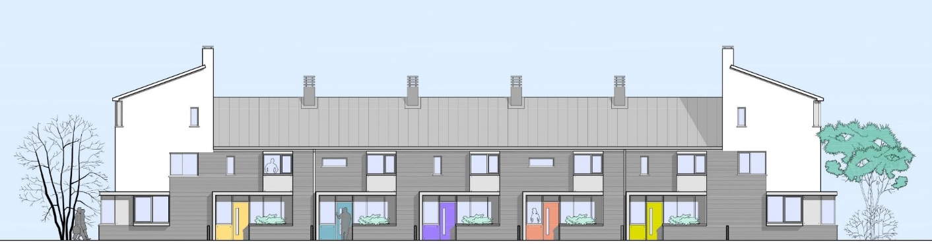
Cooperative, Affordable Homes in Sustainable Communities.
(Purchase & Rental)
A Case Study
From Immediate Need
to Sustainable Solutions:
Preventing Homelessness in Galway City
Building communities –
not just houses.
Monday 26th
February
Harbour Hotel
Galway
Hugh Brennan
www.ocualann.ie

Slide 2

About Ó Cualann…
(2014) Co-op housing org. - On the principles of Cohousing
'Building Communities - not just Houses’
Our Vision - fully integrated, (mixed income, mixed age, mixed ethnicity, mixed mobility, mixed needs) sustainable communities - ‘owner members’ will live side by side with ‘tenant members’ in social and private rented homes, sharing common amenities – a Common House, Community Garden, playground etc
Approved Housing Body (AHB) status
Member of ICSH
‘Not for Profit’ company limited by guarantee. (CLG)
Governed by a board of directors acting on a voluntary basis
Professional Management Team
Guided by Common Charter prepared by Members

Slide 3
Objectives: Affordable homes Sustainable communities…
To make available quality housing in sustainable communities at affordable prices to people whose needs are not adequately served by the market and who do not qualify for social housing
Affordability?...Spend on housing ≤ 30% net income or
  Loan to income ratio ≤ 3.5 (per central bank)
  Low cost local authority mortgages
Household income between €36k & €79k per annum
This amounts to 40% of the population
(In 2015, only 7% of house sales were to this cohort)

Slide 4

Poppintree
49 Cooperative, Affordable Type homes – all pre sold.
Made possible with support from DCC - land at €1,000 per house plot and waive development and planning levies.
Ó Cualann surplus – max 5%
Fixed price – no variation contract with builder
Started on site on 20 Oct 2016
1st 9 homes Handover July 2017
Phase 1 Completed, 17 houses occupied – Bank paid in full – Contractor paid in full
…Roads & services provided.
Eligibility Criteria developed by Ó Cualann and DCC
10 Year ‘Gain sharing’ / Clawback provision in favour of DCC
20 Year ‘Gain sharing’ / Clawback provision in favour of DCC on future schemes

Slide 5
Common Charter
Put work into building the community first:
“…people get to know their neighbours before they move in,
where they all look out for each other,
where mortgages do not cripple them,
where energy bills are low,
where homes are guaranteed to be built to the best international standards,
where people feel safe and secure...”
Right to Safety & Security:
All residents have a right to live in a safe and secure environment
All residents will ensure that they and their visitors will observe traffic regulations especially with regard to speed and parking…
Right to Privacy:
All residents have the right to have their privacy respected by their neighbours
All residents will respect the privacy of their neighbours and in particular will respect a family’s right to privacy…
Each household has right to a designated parking space:
All residents will respect the designated parking spaces in front of the houses which do not have a driveway…
Right to fair procedure in the selection and allocation of houses:
All prospective purchasers will abide by the eligibility criteria ….
Notes:
Common Charter
Poppintree Project
Vision: To live in a caring & supportive community which respects and is generous towards the residents, their property and their social boundaries.
Mission: To create an open and supportive environment where all residents can communicate freely with each other, where diverse views are respected, where family life and privacy is valued, where residents look out for each other and where everyone actively contributes to the community.
Values: Community, Cooperation, Respect, Openness, Equality, Democracy, Tolerance, Fairness, Hospitality, Privacy, Security.
Stakeholders:
All Residents of the Ó Cualann Poppintree cooperative development.
Ó Cualann Cohousing Alliance as the Cooperative structure and developer.
Dublin City Council.
Assumptions:
That a residents’ association will be established when houses are occupied and that all residents will become active members of the residents’ association and sign the common charter. A representative caretaker committee will be set up in the interim during the construction phase.
That all residents of will be of good character.
That all residents will use ‘common sense’ in their dealings with each other.
That all residents will treat each other, our families and visitors with respect.
That residents will be security conscious and will use active & passive surveillance methods to keep our community secure, whilst, at the same time, being conscious of the nuisance that can be caused by sensitive house & car alarms.
That DCC will develop the open space to the East of our site for recreational use.
That Ó Cualann will continue to facilitate community development before and after occupation of the homes.
That a constructive relationship will be established with the community Gardaí in the locality.
That dog owners will be responsible for their dogs and will clean up any fowling by their dogs in public areas.
Rights and responsibilities:
Right to Safety & Security.
All residents have a right to live in a safe and secure environment.
Responsibilities:
All residents will ensure that they and their visitors will observe traffic regulations especially with regard to speed and parking.
We will give priority to pedestrians and cyclists ahead of cars on the roads in our community. In effect this means that cars must always give way to pedestrians, cyclists and children on the roads in our community.
Cars must, of course be permitted to use the roads but only in a safe manner that recognises the priority given to pedestrians.
All residents will actively keep their gardens, and the public paths and grass verges in the community in a clean and tidy condition.
That all adult members of the community will be aware of their own personal behaviour in order give good example to the children in the community.
Whilst recognising that children & teenagers will misbehave from time to time, anti-social behaviour will not be tolerated in our community.
Right to Privacy:
All residents have the right to have their privacy respected by their neighbours.
Responsibilities:
All residents will respect the privacy of their neighbours and in particular will respect a family’s right to privacy.
Whilst recognising the importance of community we also recognise the right of individuals and families to retreat to the privacy & comfort of their own homes.
Each household has right to a designated parking space.
Responsibilities:
All residents will respect the designated parking spaces in front of the houses which do not have a driveway and will request their visitors not to park in these designated spaces.
Designated Parking spaces will be marked with house numbers and visitor spaces with a ‘V’.
Right to fair procedure in the selection and allocation of houses.
Responsibilities:
All prospective purchasers will abide by the eligibility criteria and the general procedures below for the allocation of the houses.
Whilst previous members of CTSL and Parkside have first preference in the choice of the houses, this preference must be exercised by Tue 31st MAY 2016 when a general meeting will be held for prospective purchasers to choose their preferred houses. This is necessary to ensure other purchasers cannot be displaced once a house has been allocated.
To confirm that a house has been chosen and allocated, each purchaser will be required to pay a booking deposit of €2,000. (The booking deposit is refundable) Once this booking deposit has been accepted by Ó Cualann the house is deemed to be allocated and the purchasers will become members of Ó Cualann and their names will be added to the register of members. This membership confers voting rights at the AGM.
An independent, 3 person house allocation committee will be established to arbitrate in the event of any disputes with regard to house choice/allocation and all prospective purchasers agree to be bound by the decision of the committee.
The house allocation committee will comprise Jon Butterly (Chair) and two professional people from the voluntary housing sector.
Name:
First Preference House No:
Second Preference House No:
Third Preference House No:
I/we agree to abide by the common charter including the house selection/allocation procedure, the eligibility criteria and the clawback arrangements.
I/we confirm that the chosen house will be used as my/our Principal Private Residence and that I/we accept that no letting or assignment of the property will permitted for the first ten years of occupation, except as may be permitted under the ‘Rent a Room’ scheme.
Signature
Date

Slide 6
Eligibility Criteria
At least 70% of purchasers should be currently living or working in Dublin North West area
Each purchaser must sign and agree to be bound by the common charter and must agree to the ‘Gain-sharing/ Clawback Arrangements’
…must be a First Time Buyer. In case of joint applicants, neither applicant can be a previous owner or current owner of a property. This requirement may be exempted in the case of persons who are separated or divorced
…must have earned under €59,000 and €79,000 in the previous tax year in respect of single applicants and joint applicants respectively. This must be verified by P60 for PAYE workers or by certified accounts by self-employed workers
…must in possession of a minimum deposit of 10% of the purchase price of the property; this deposit will be used as part of the construction finance
…must in possession of full mortgage approval in respect of the balance of the purchase price
…must have an indefinite right to remain in Ireland either through nationality or refugee status
Eligibility will be assessed by an independent Qualified Financial Advisor who will be appointed by the AHB or Co-op with the agreement of the Local Authority
Houses will be allocated to prospective purchasers, on a first come, first served basis, allowing for the preferences above, according as they meet all of the above eligibility criteria

Slide 7
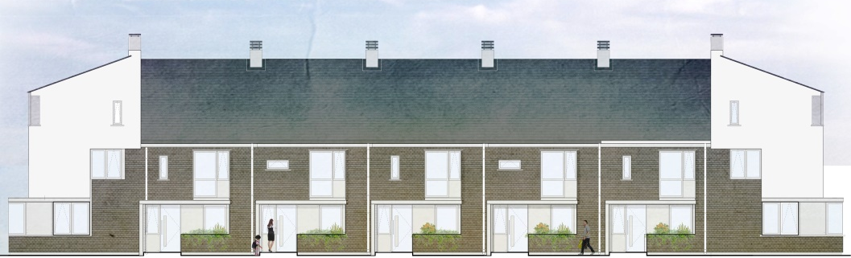
Specs.
Details & Specification:
• Architect Designed scheme
• BER A2 Rated.
• Fitted kitchen and wardrobes; Floor Tiles in hall, bathrooms and kitchen
• Finished semi solid wood floors upstairs
• Air Source Heat-Pump
• Space heater in the living room
• PV Solar Panels on the roof
• Bin storage to front; Paving to the front path & driveway
• Garden shed and water butt to the rear; Planting & trees to rear gardens
• Parking for all houses.
• …Provide homes at a cost of €170 to €180 per ft² incl. VAT*
• …typical 3 Bed home of 1,100ft² -between €187,000 - €198,000 incl. VAT*
* (Depending on spec and site cost, conditions etc.)

Slide 8
Funding & Finance…
The model is affordable for all members and is funded as follows:
Members: booking deposit used for Planning Process say €5k
…10% deposits (incl booking dep) used for construction finance and guaranteed by HomeBond
…savings invested to reduce bank borrowings; return of say. 4% per yr. Deducted from the sale price
Bank for remainder of construction finance –
(currently 5.6% + facility fee + Legal + Monitor + Valuer. Total approx. 7%)
Land provided at a substantial discount. (€1,000 per house plot)
Development levies waived for Approved Housing Body (AHB)
No Developers margin. (min 5% surplus required for Due Diligence)
Fixed price – no variation contract with builder
This results in housing being delivered at an affordable price and they cannot be sold or let for a period of time, typically 10 to 20 years without triggering a ‘gain-sharing’ or ‘Clawback’ arrangement

Slide 9
Poppintree Clawback
…homes sold to members at approx. 25% - 30% discount to similar houses in local market
…discount possible because of the disposal of the site at a nominal value by Local Authority and there will be no levies, - no profit for the developer. (5% Surplus after all charges)
In the spirit of cooperative housing it is important that members do not exploit the early sale of their homes; consequently, a Gainsharing / Clawback Arrangement will be put in place in favour of Local Authority for 20 years
* …clawback, as follows:
Current Open Market Site Value X Subsequent Disposal Price/Market Value
Affordable Cooperative Purchase Price
Example: Sale for €260,000 Sale for €190,000
(€30,000 x €260,000)/170,000 = €45,882 (€30,000 x €190,000)/€170,000 = €33,529
Total Gain = (€260,000 - €170,000) = €90,000 Total gain = (€190,000 -€170,000) = €20,000
Council Clawback = €45,882 Council Clawback = €20,000
Purchaser gain = €44,118 Purchaser gain = €0

Slide 10
Funding Matrix
 | Owner Occupiers | Private Rental | Social Rental | Rent to Own
Short term Construction finance | Private funding through Banks arranged by O Cualann; or via the O Cualann Loan Notes or both. | Private funding through Banks or via the O Cualann Loan Notes or through partnerships with AHB's or a mix. | Various Government Financing arrangements: CAS/CALF perhaps in partnership with other AHB. | Extended 3 -5 yr. Private funding through Banks arranged by O Cualann; or via the O Cualann Loan Notes.
Long term Purchase Funding | Members' personal mortgages arranged by members with assistance from O Cualann. | Partnerships with other AHB's or via O Cualann Reserves with additional 10/15 yr. private finance. | Various Government Financing arrangements: CAS/CALF perhaps in partnership with other AHB. | Members' personal mortgages, after 3 years, arranged by members with assistance from O Cualann.

Slide 11
Rent to Own Scheme…

Slide 13
Unintended Positive Consequences of Ó Cualann model.
Affordability feed into many areas of our lives
Earnings & Competitiveness
Local Economy:
Ó Cualann Members:
12% Ex Council tenants
28% Living with family/friends
60% renting @ average rent of €1,400 per month (Available for new private Tenants)
Average Mortgage payment will be € 880 per month
€520 per household per month available to member for spending/saving.
Assume 40% of this is either saved or spent on imports or holidays etc.
Assume 60% is available for local spending - €312
There is capacity on existing sites in Ballymun for 2,000 Affordable Type Co-op homes
Assume 60% of new members are also renting
.6 x 2,000 x €312
= €374,400 per month
= €4.5 million per year
Allow a multiplier* of 3.
€13,000,000 available per year as additional income in local economy.
With Affordable Cooperative housing – even Capitalism works!!
Notes:
*The multiplier effect
Every time there is an injection of new capital into the circular flow there is likely to be a multiplier effect. An injection of extra income leads to more spending, which creates more income, and so on. The multiplier effect refers to the increase in final income arising from any new injection of spending.
The size of the multiplier depends upon household’s marginal decisions to spend, called the marginal propensity to consume (mpc), or to save called the marginal propensity to save (mps).
It is important to remember that when income is spent, this spending becomes someone else’s income, and so on.
Marginal propensities show the proportion of extra income allocated to particular activities, such as s saving by households, and spending on imports from abroad. For example, if 80% of all new income in a given period of time is spent on Irish or local products, the marginal propensity to consume would be 80/100, which is 0.8.
The following general formula to calculate the multiplier uses marginal propensities, as follows: 1/1-mpc
Hence, if consumers spend 0.8 and save 0.2 of every €1 of extra income, the multiplier will be:
1/1-0.8 = 1/0.2 = 5
Hence, the multiplier is 5, which means that every €1 of new income generates €5 of extra income.

Slide 14
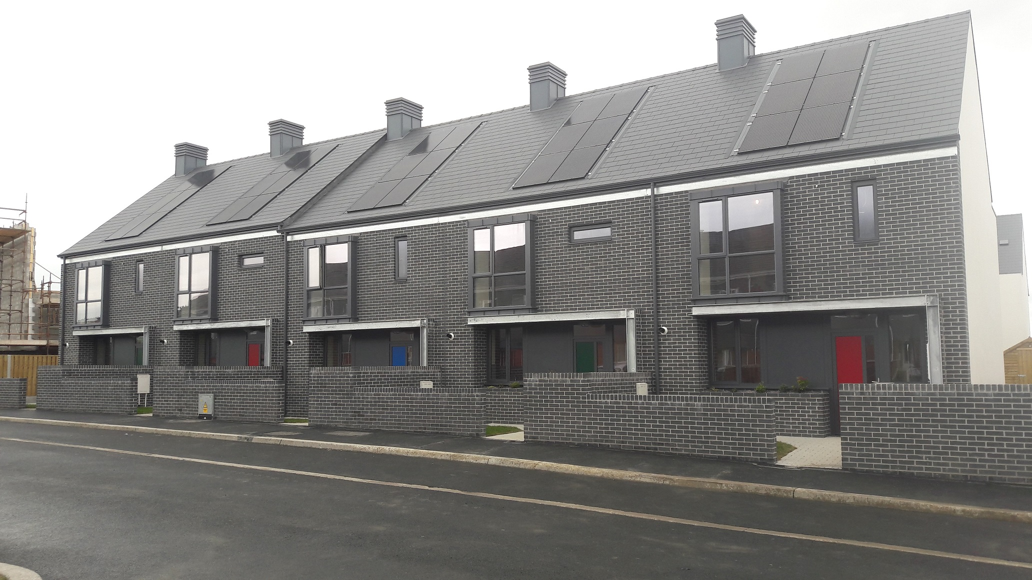

Slide 15
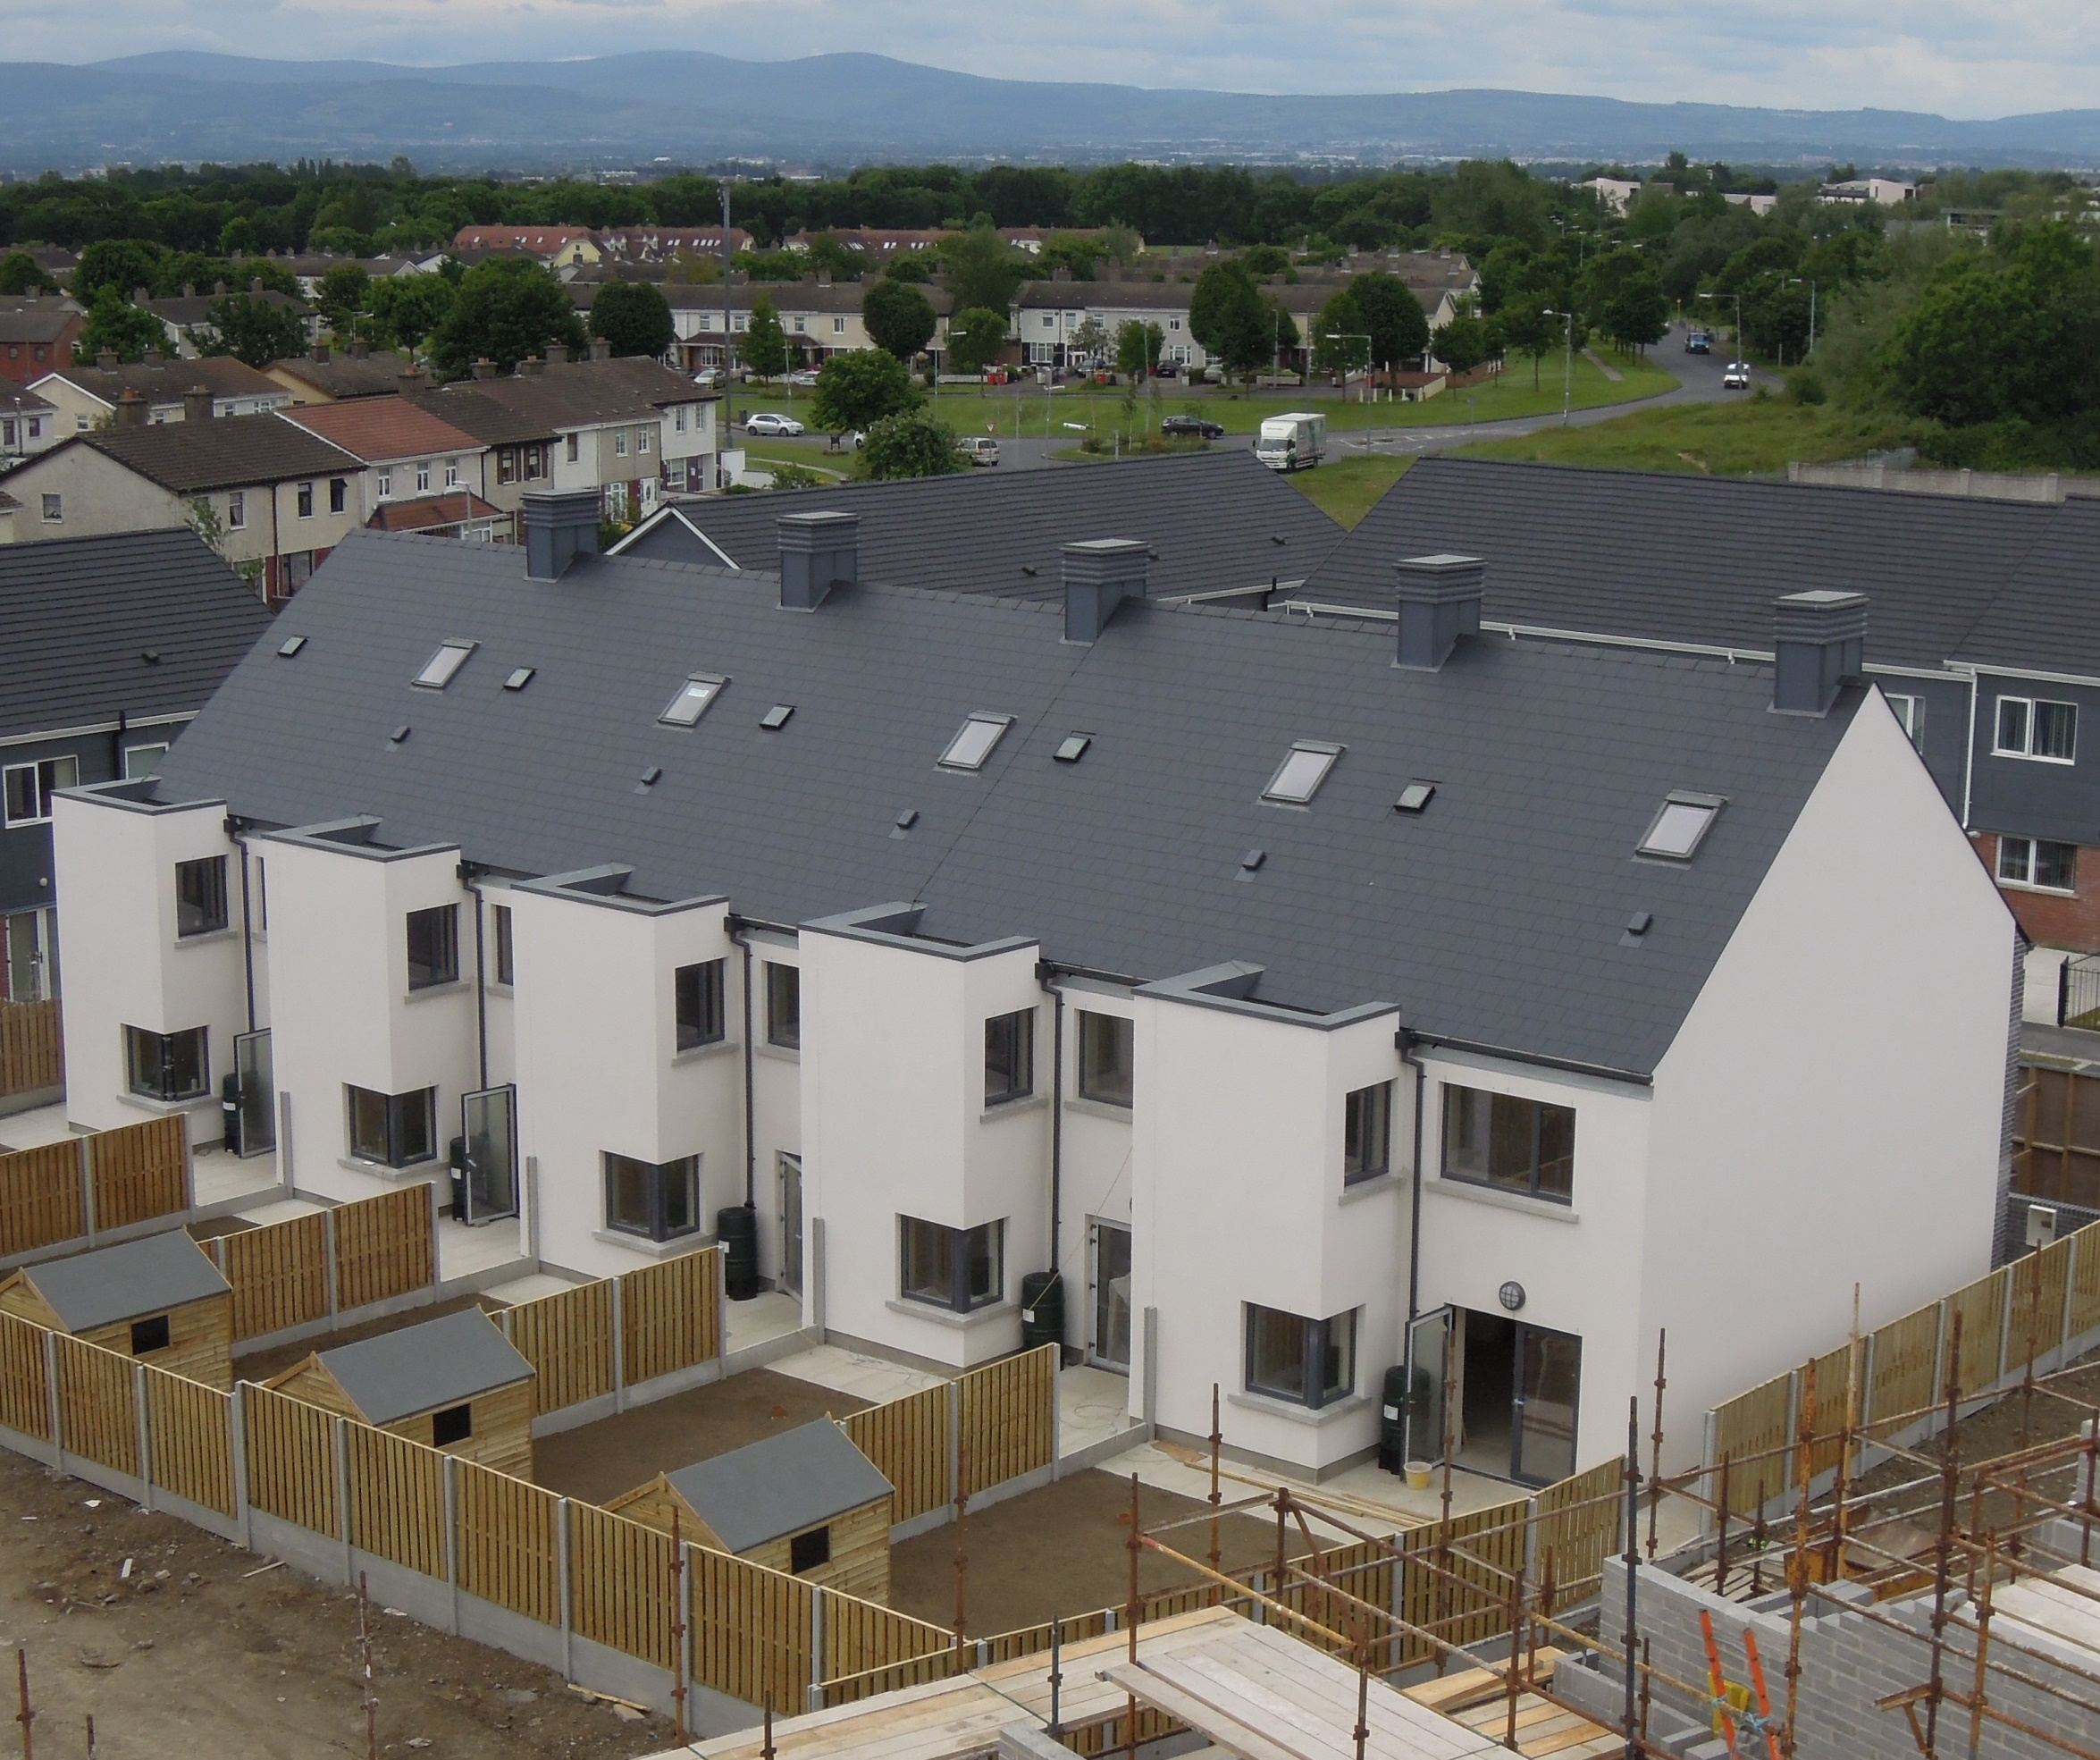

Slide 16
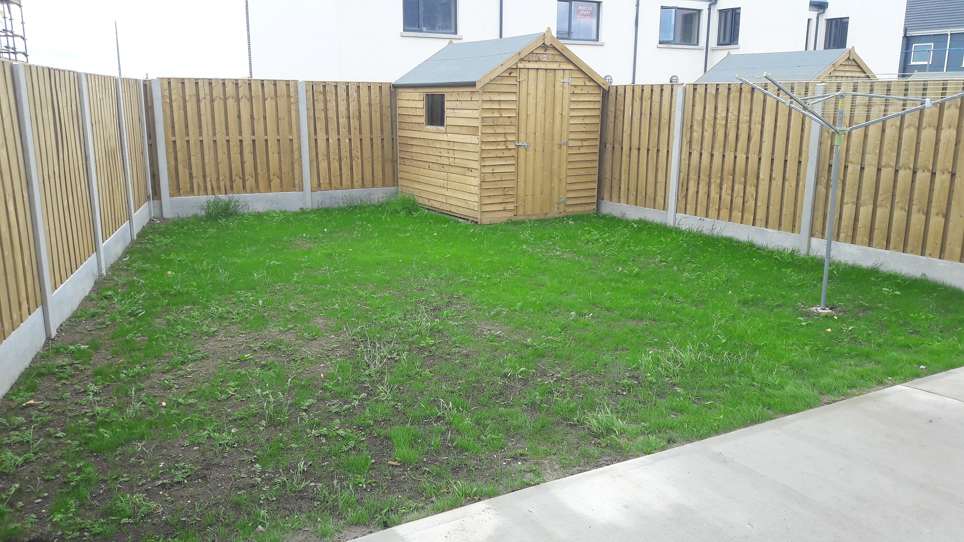

Slide 17
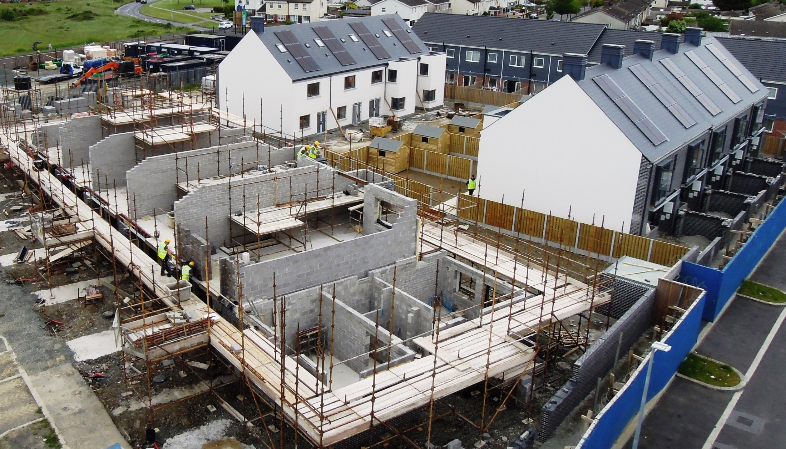

Slide 18
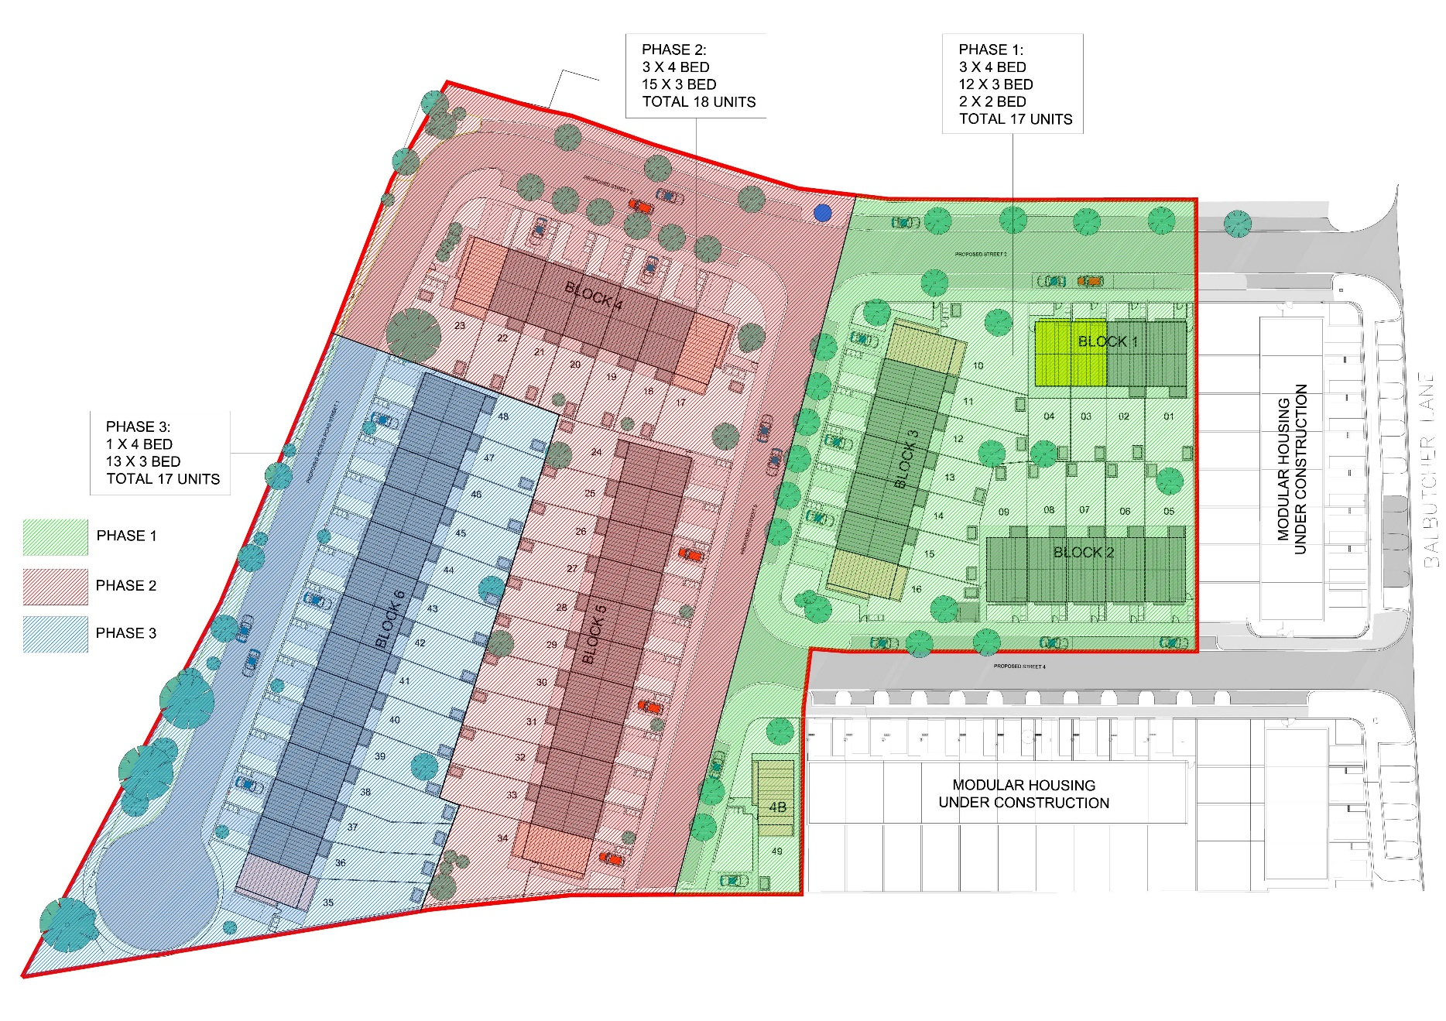


Slide 19
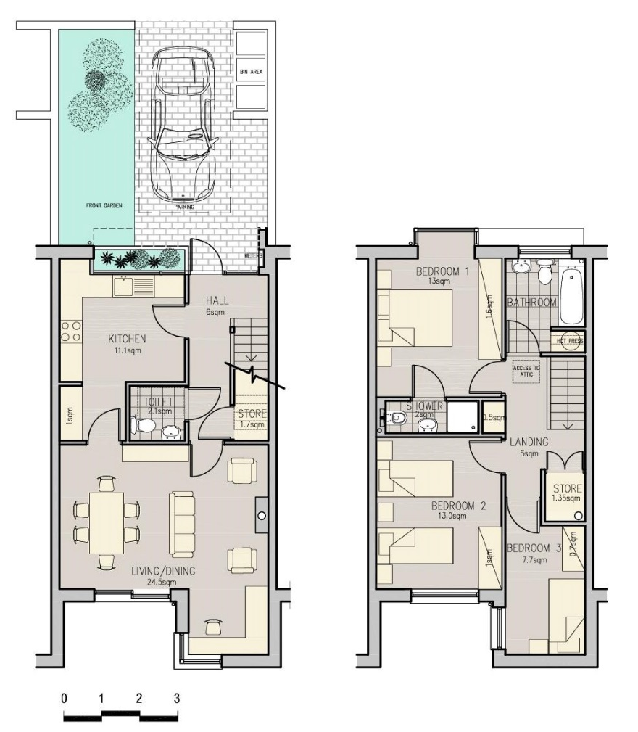
3 BED
FLOOR PLANS
Average Price Phase 2 :
€177,700 incl VAT.
GROUND FLOOR – 49.5SQM
FIRST FLOOR – 52.5SQM

Slide 20
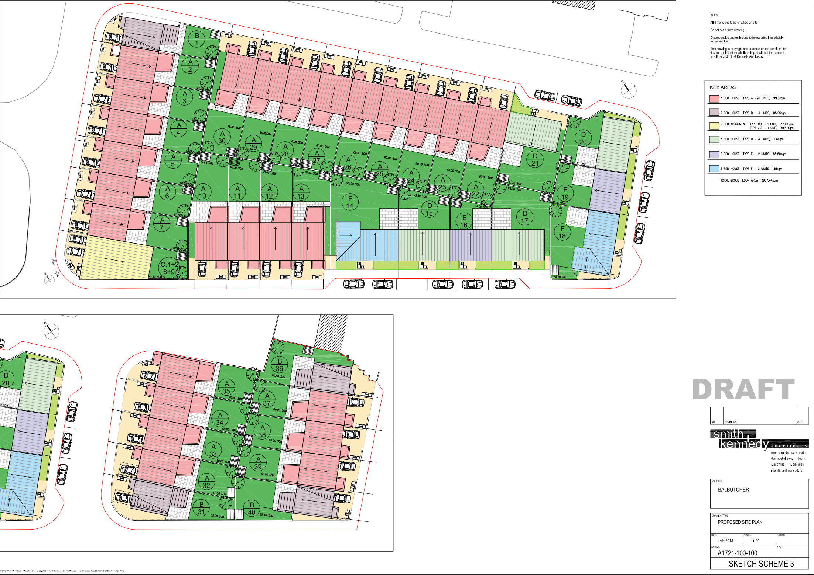

Slide 21

The time is Right for Cooperative Affordable Housing
There is a tide in the affairs of men,
which, taken at the flood, leads on to fortune;
omitted, all the voyage of their life
is bound in shallows and in miseries.
On such a full sea are we now afloat;
and we must take the current when it serves,
or lose our ventures.
Shakespeare, Julius Caesar Act 4 Scene 3 – Brutus to Cassius

Slide 22

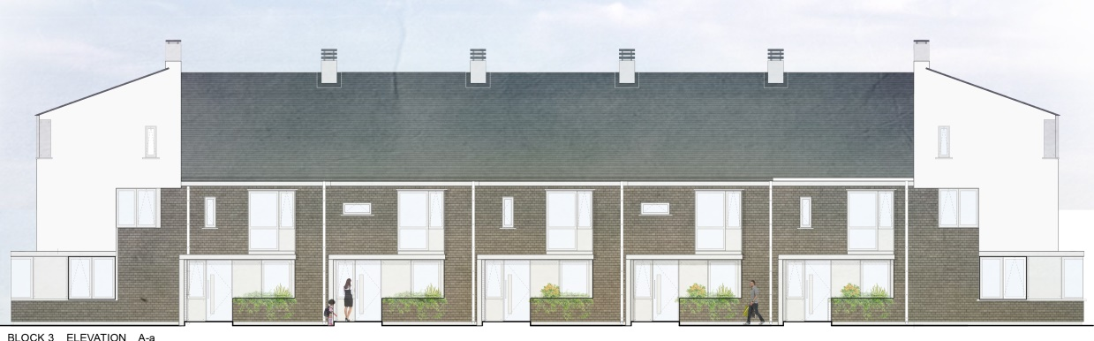


Go raibh maith agaibh!
Ceistenna?
www.ocualann.ie

Slide 23
Links: http://www.irishtimes.com/news/social-affairs/affordable-houses-give-hope-to-renters-1.3147111 https://www.rte.ie/news/dublin/2017/0710/889171-affordable-housing-scheme/ http://nearfm.ie/podcast/?p=22367 https://www.dublininquirer.com/2017/06/06/how-did-a-co-op-build-affordable-homes-in-ballymun-and-can-it-be-done-elsewhere/
www.ocualann.ie

